Slide 1

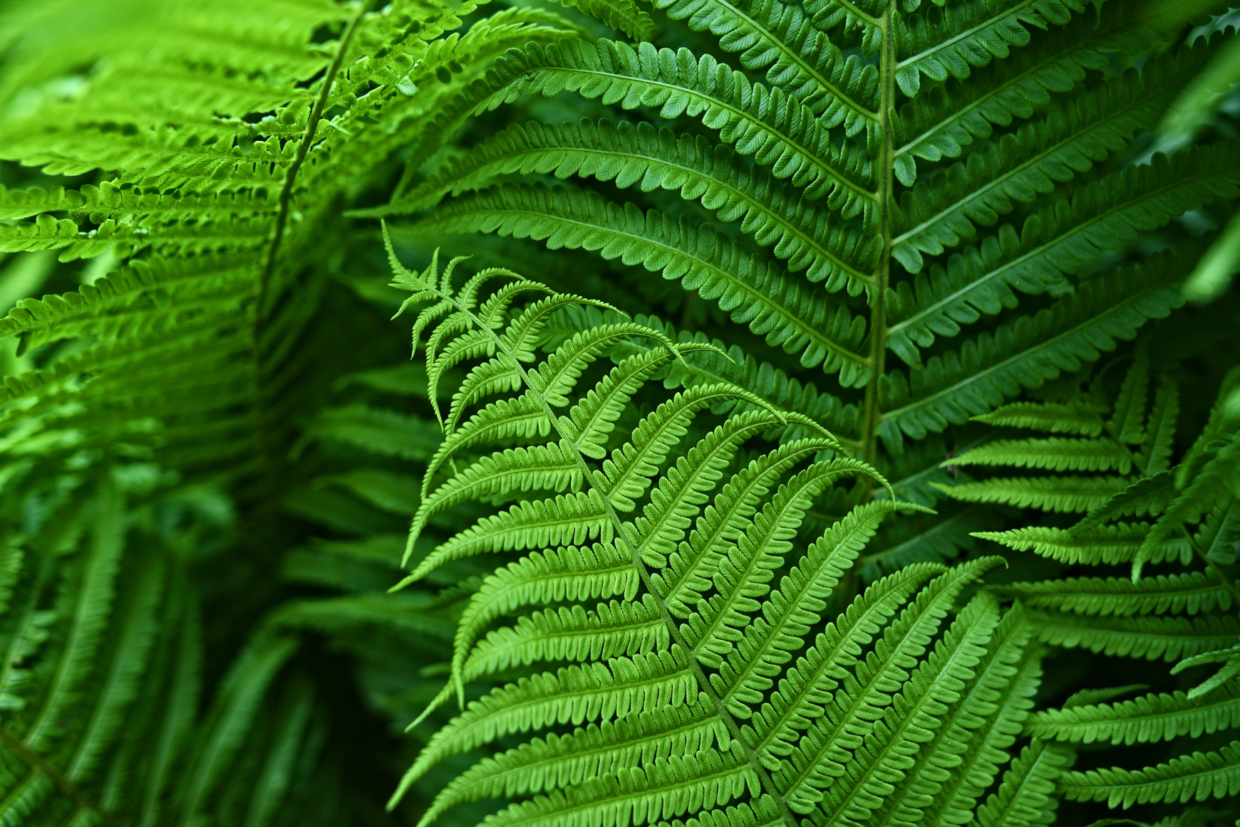
TEAM 3
FARM/GARDEN ENVIRONMENTAL MANAGEMENT SYSTEM

Slide 2
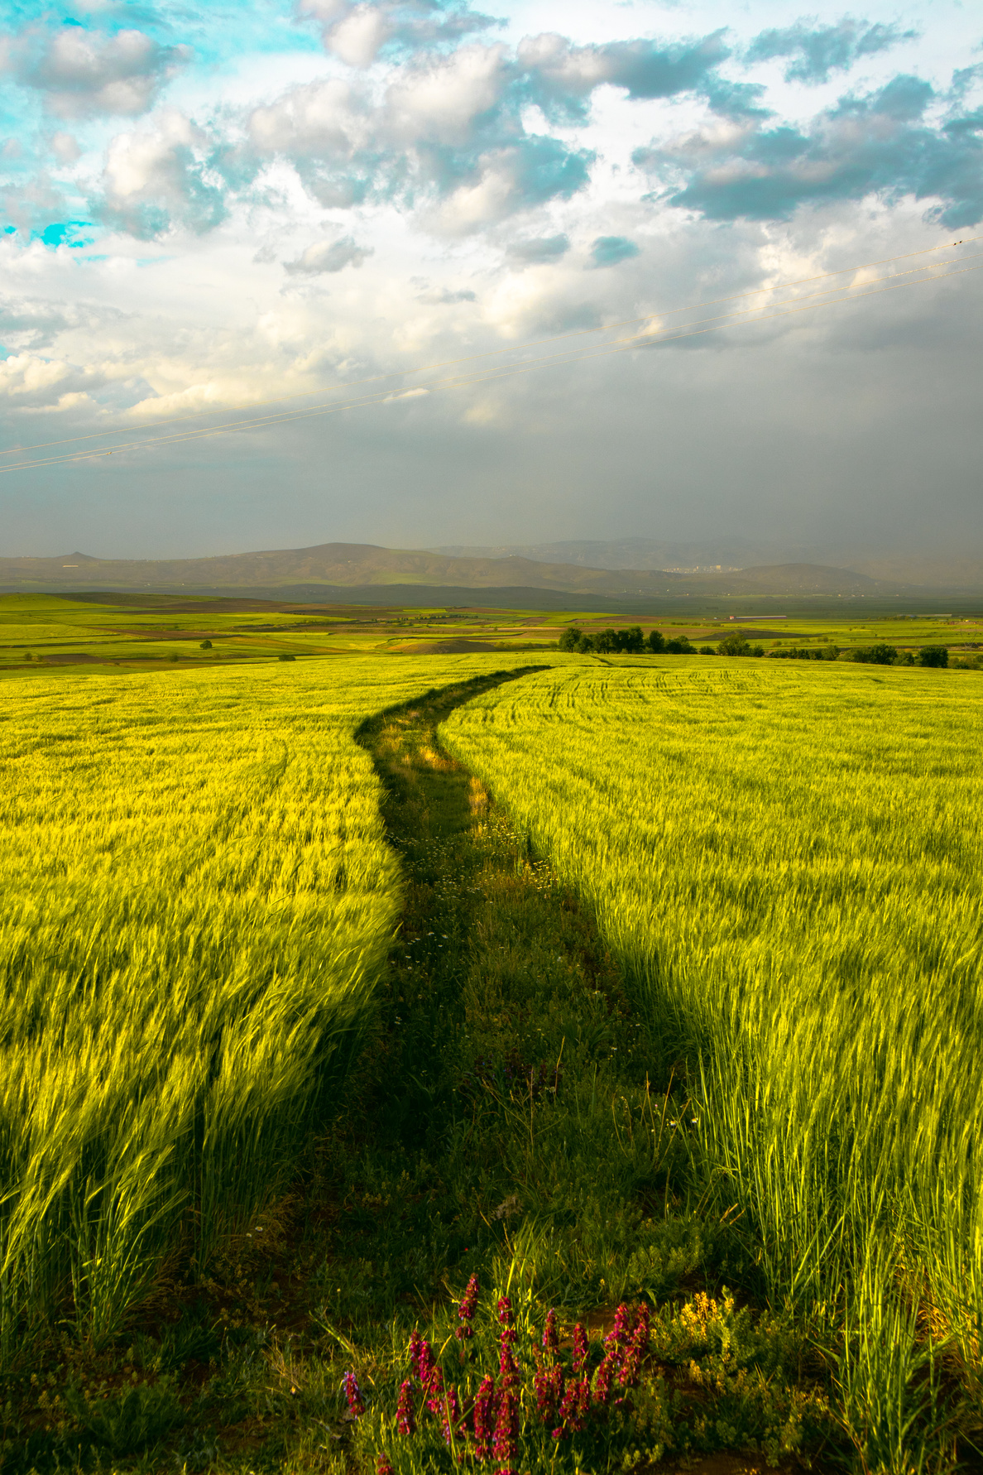
Objectives
Develop an IoT application for real-time tracking and monitoring
of environmental conditions in a garden using manipulated data in the form of sensor & weather api data, leveraging the capabilities of Azure cloud platform.
.
Key Features
Data Collection:
Integrate soil moisture sensors, weather stations for comprehensive data collection.
Insights and Decision-Making:
Utilize PowerBI for data visualizations.
Extract valuable insights to enhance decision-making regarding optimal environmental conditions.
Automation and Efficiency:
Streamline monitoring processes by automating data collection and analysis tasks.
Creating a Streamlit Dashboard for end - user application, data monitoring and tracking

Slide 3
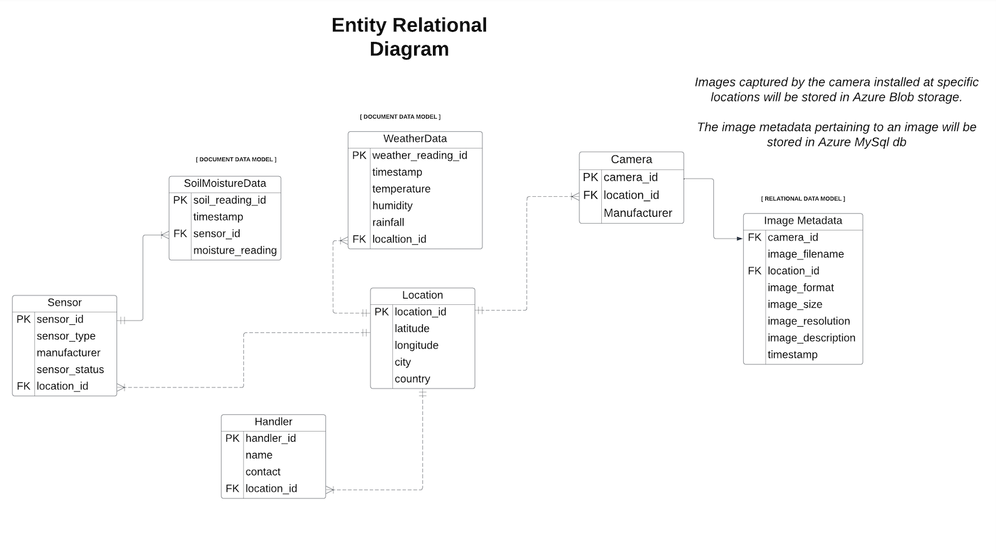
ER Diagram

Slide 4
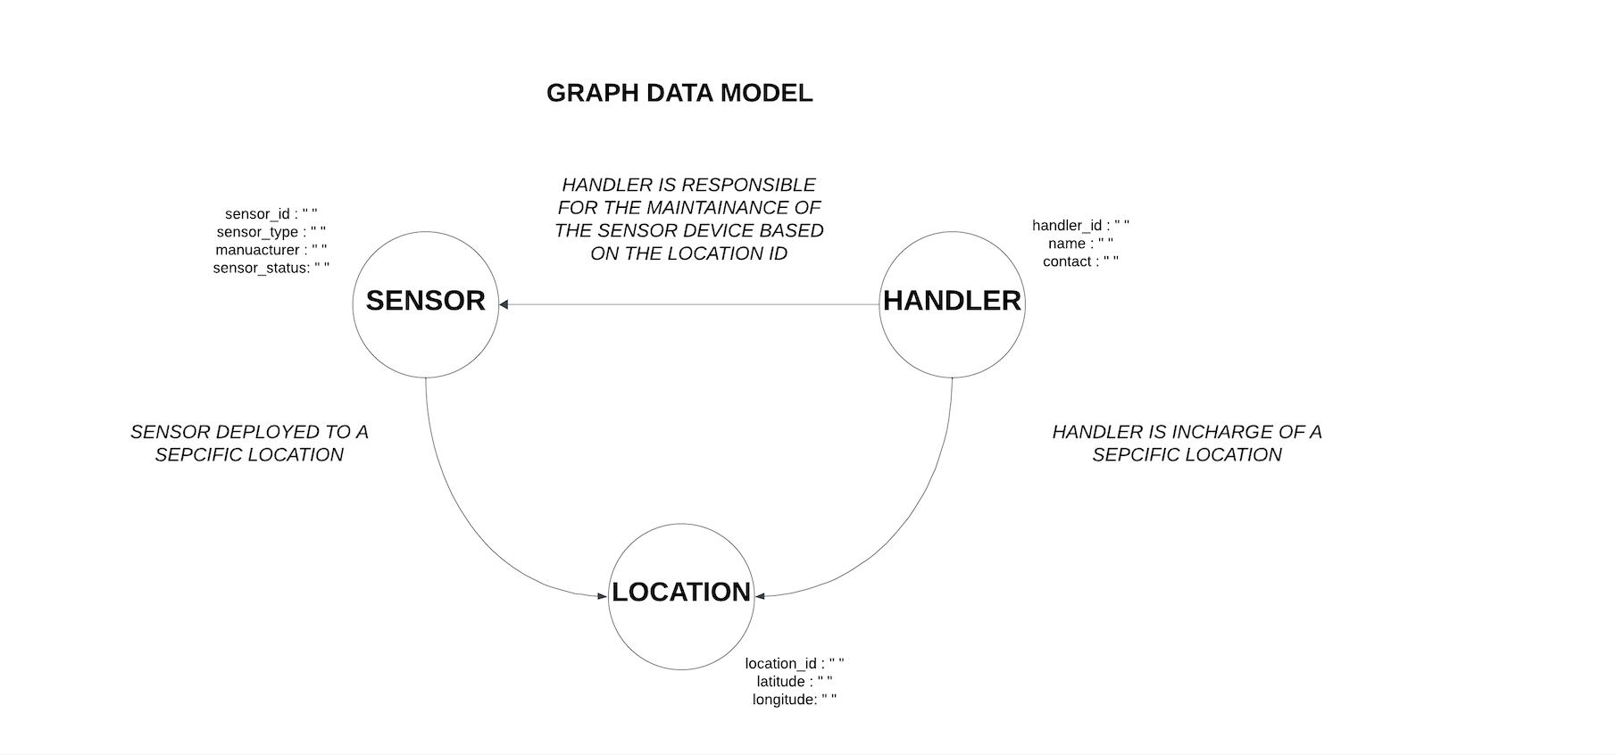
Graph Model
Diagram

Slide 5
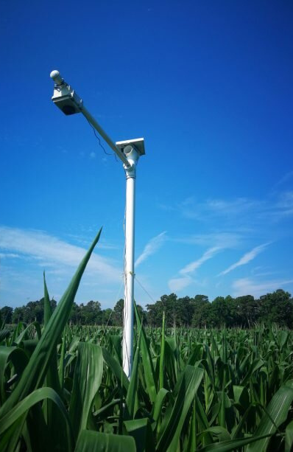
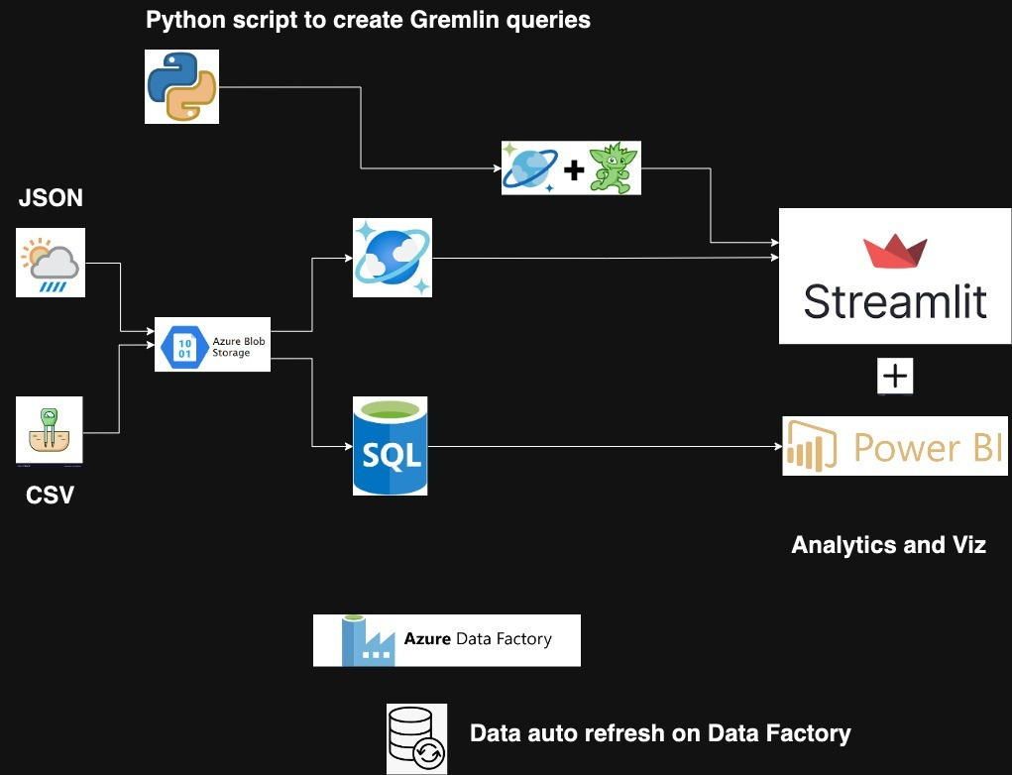
Architectural Diagram

Slide 6
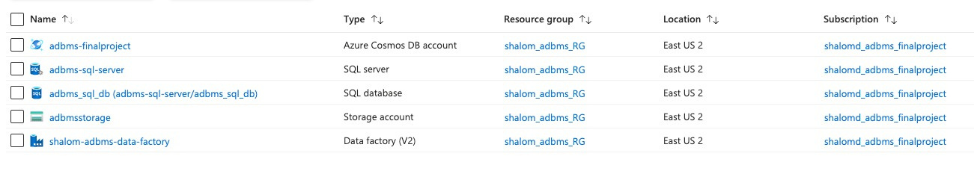
Azure services

Slide 7
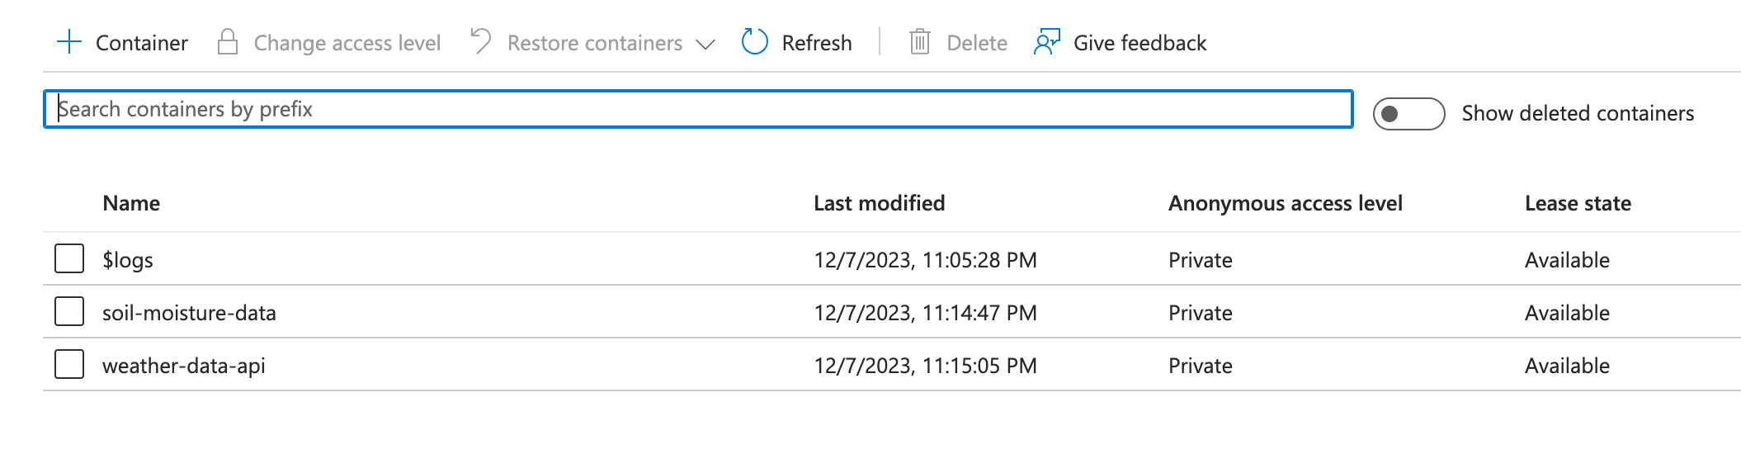
Azure blob
containers

Slide 8
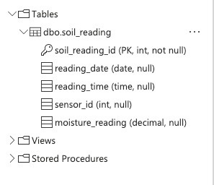
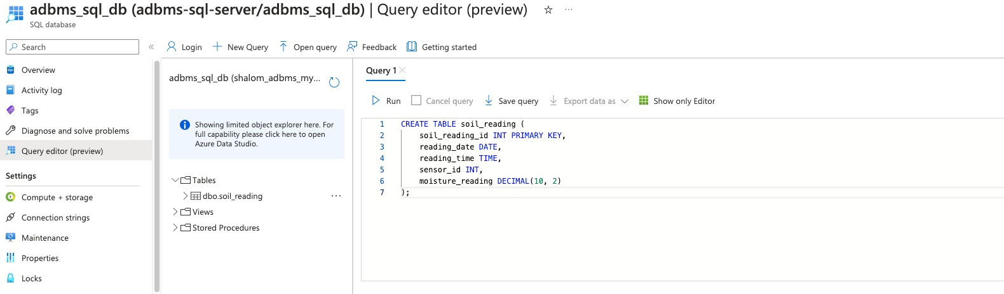
Azure SQL DB

Slide 9
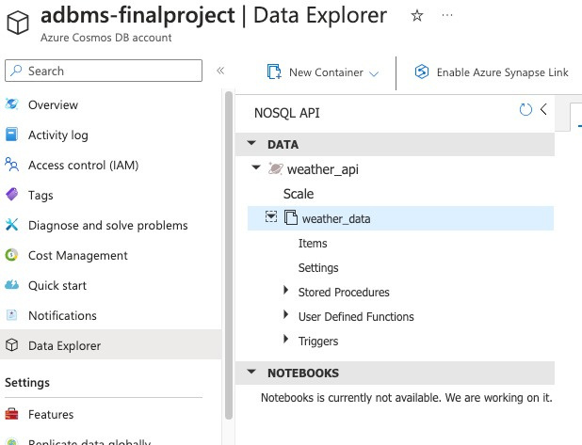
Azure Cosmos DB

Slide 10
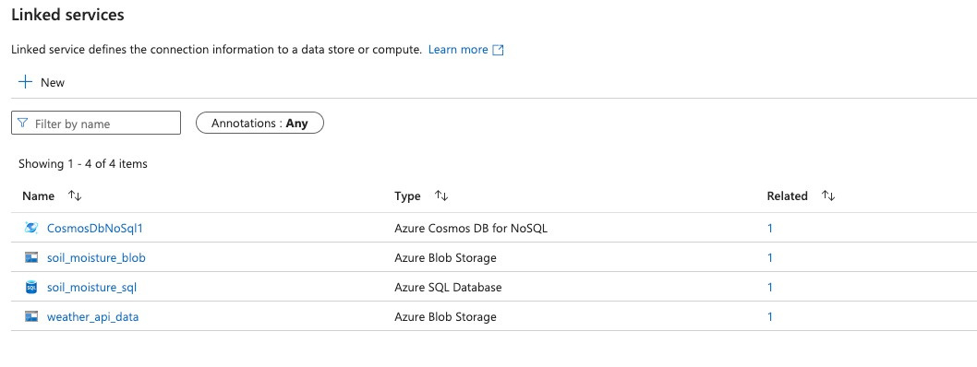
Linked Services on ADF

Slide 11
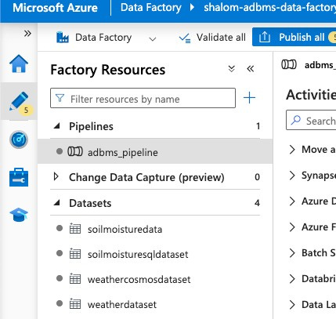
Datasets on ADF

Slide 12
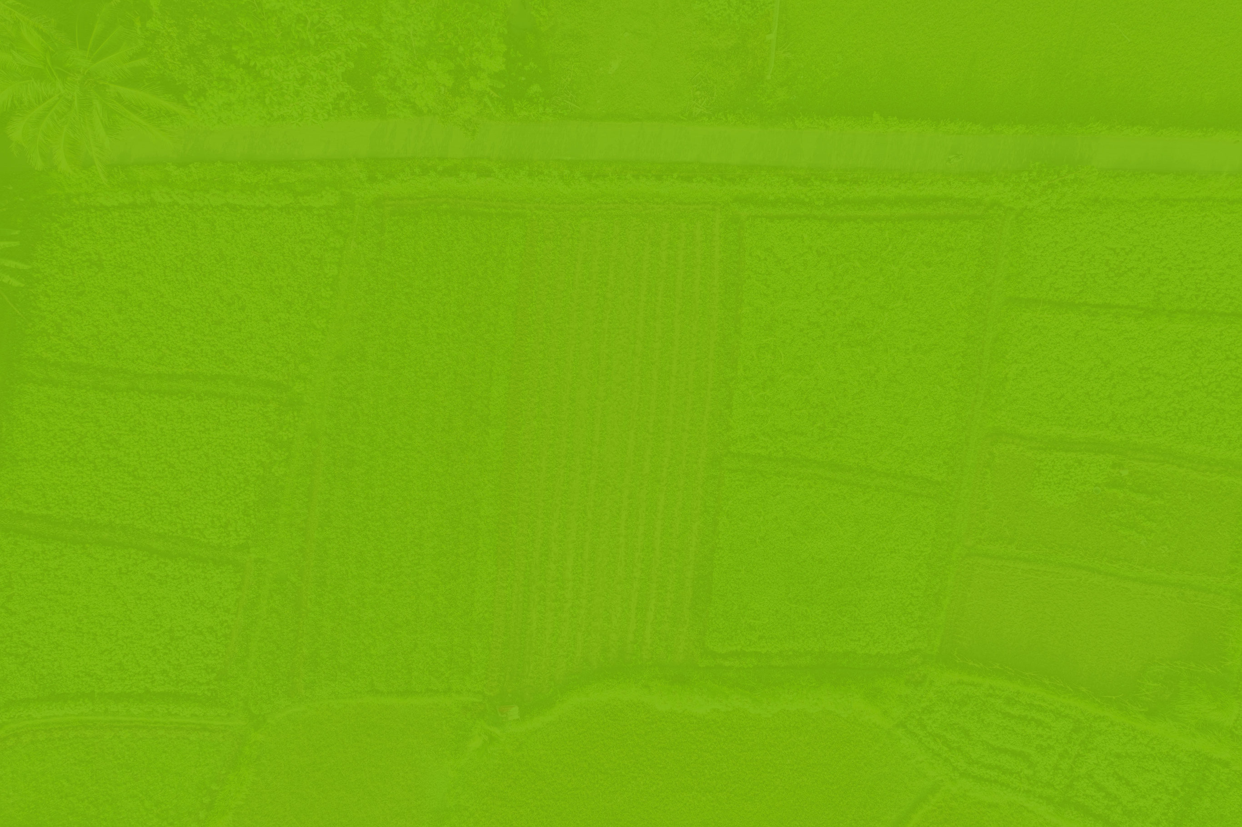
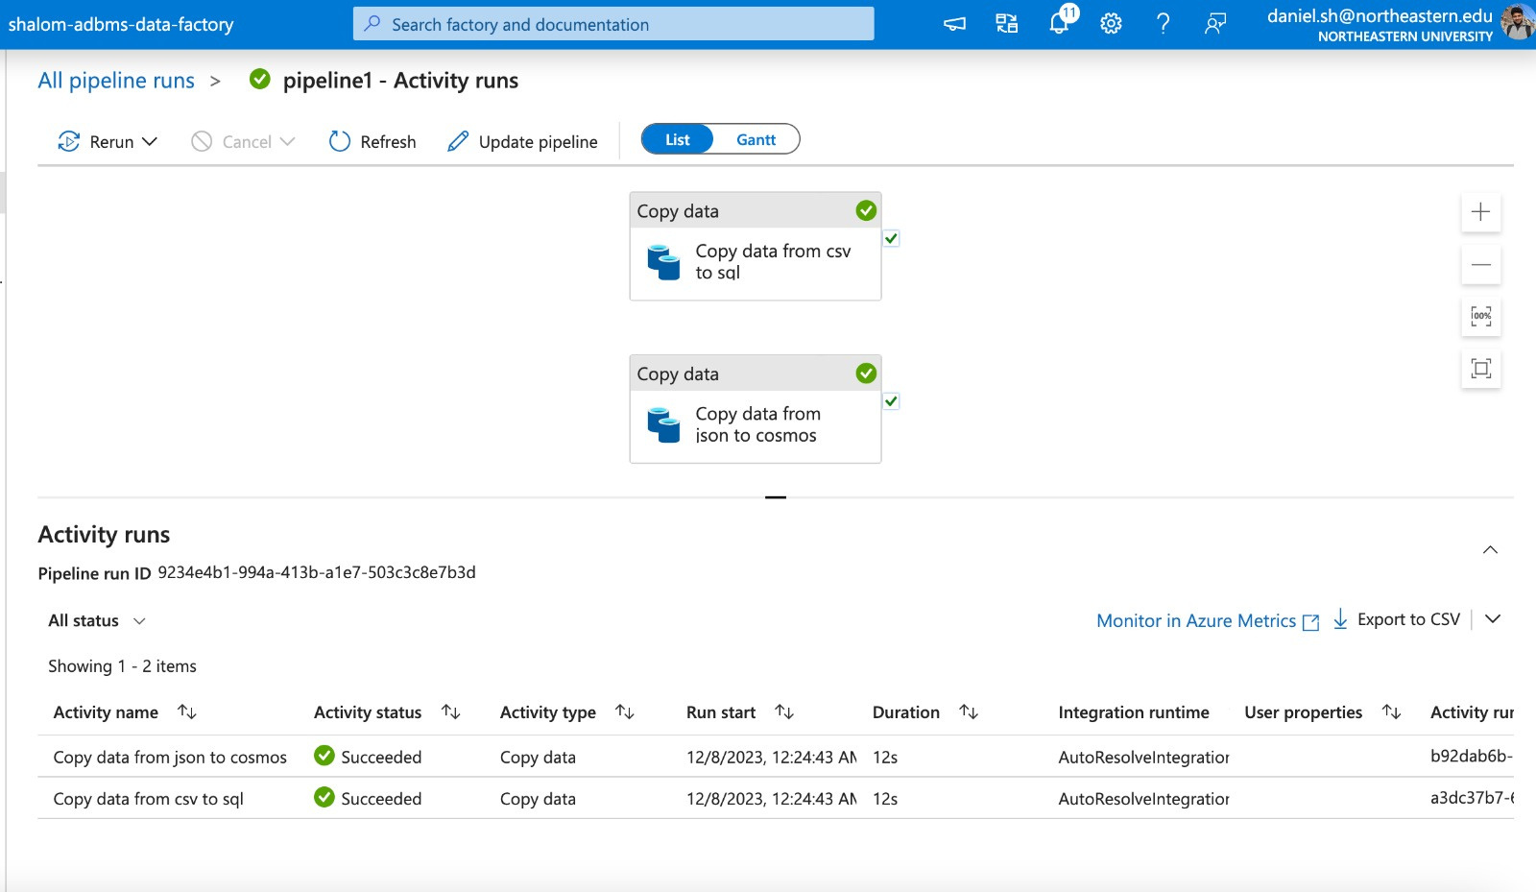

Data Pipeline Debug
READ MORE

Slide 13
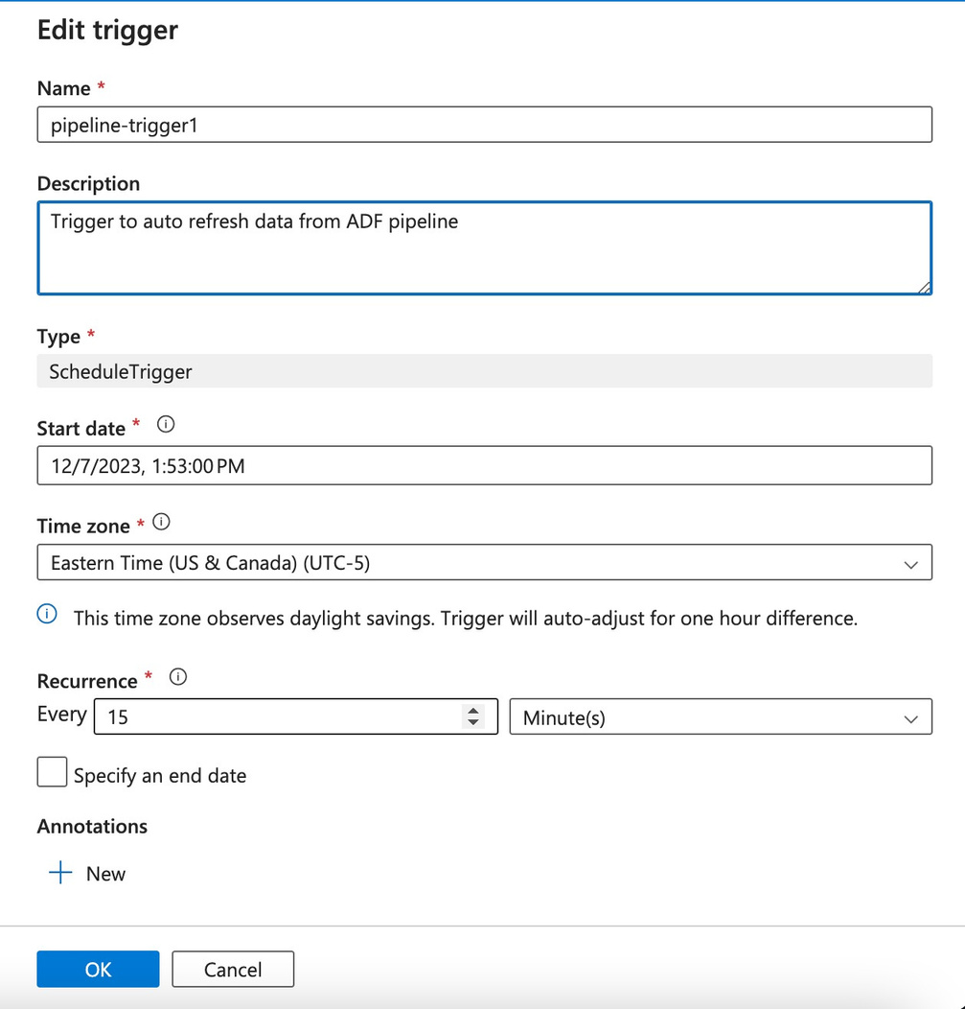
Data auto refresh using triggers

Slide 14
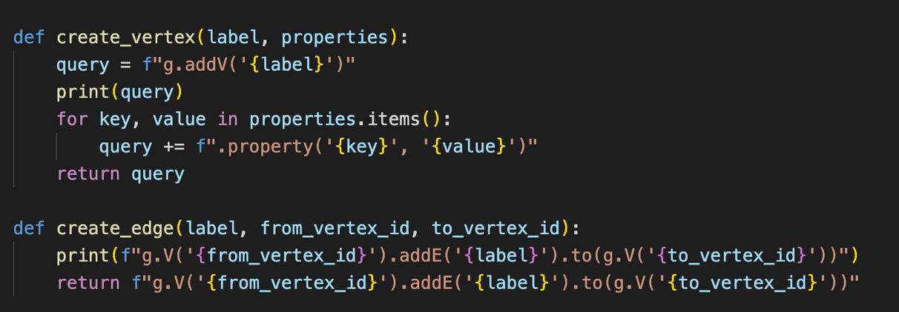
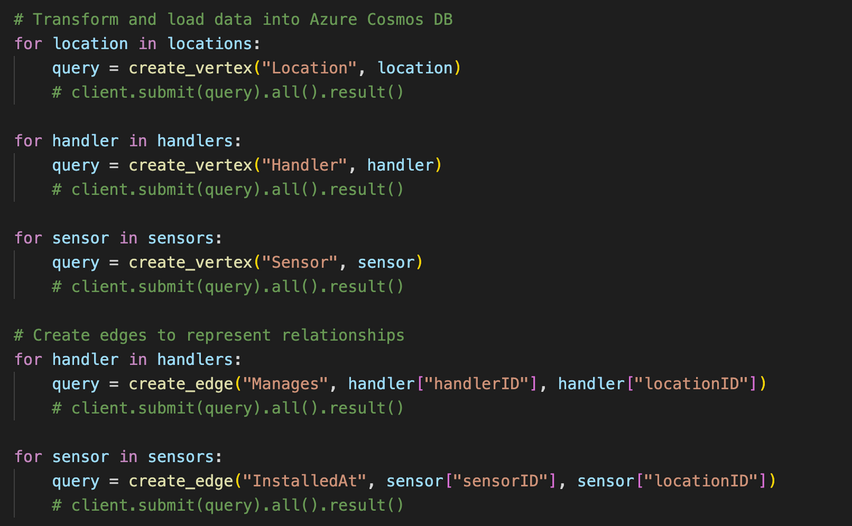
Python script to create Gremlin queries

Slide 15
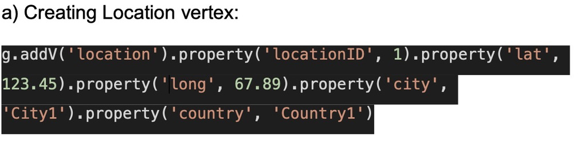
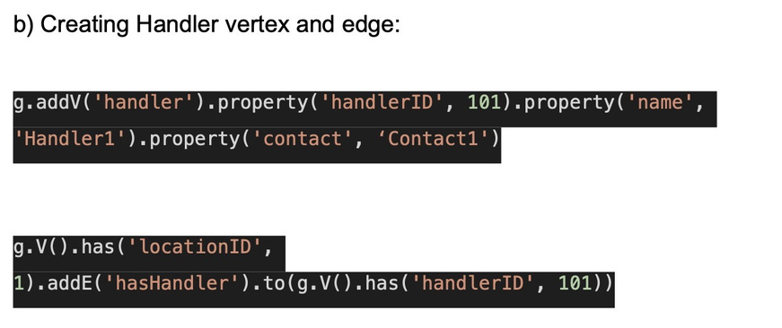
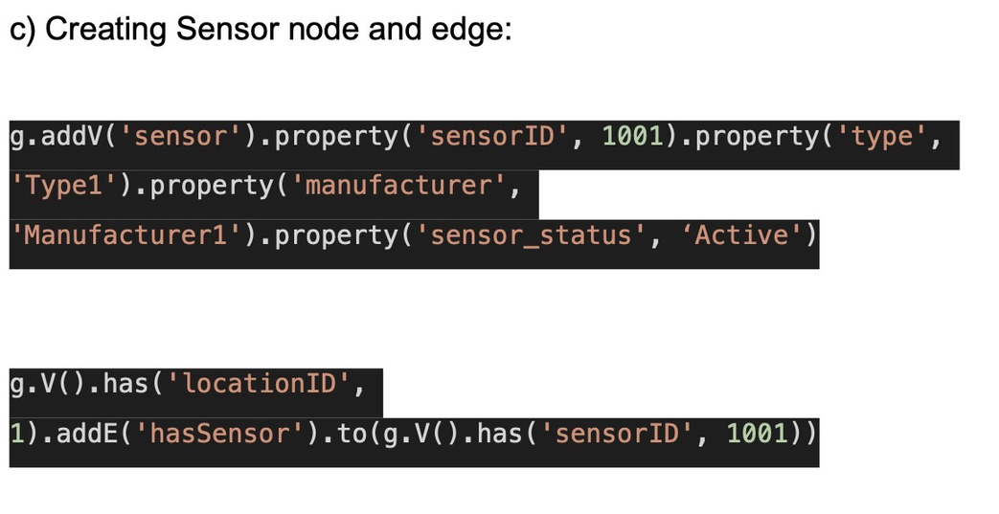
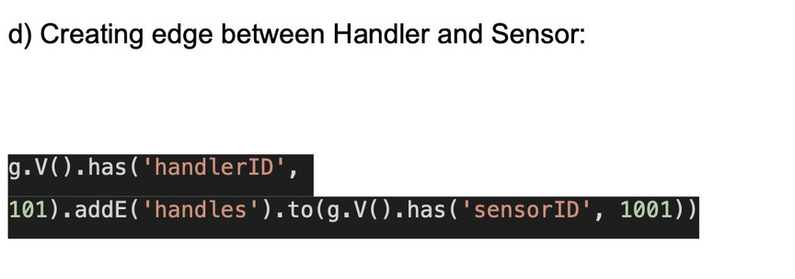

Slide 16
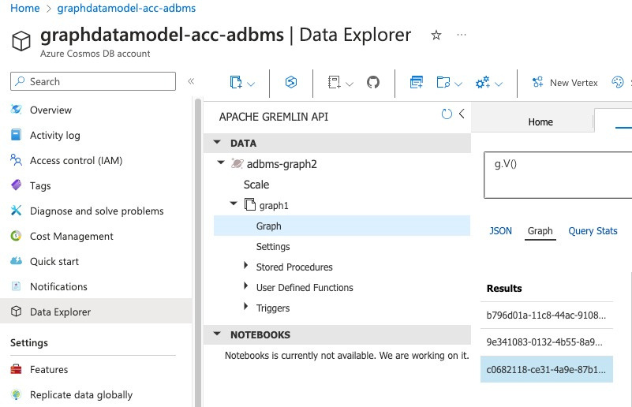
Cosmos DB with Gremlin API account

Slide 17
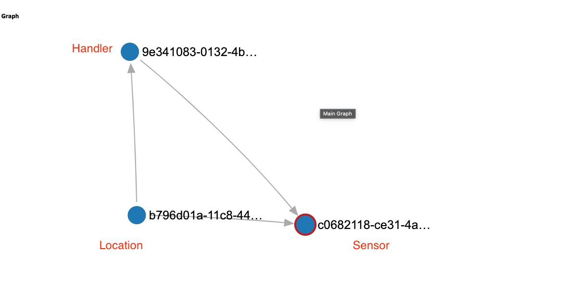
Graph Data
model

Slide 18
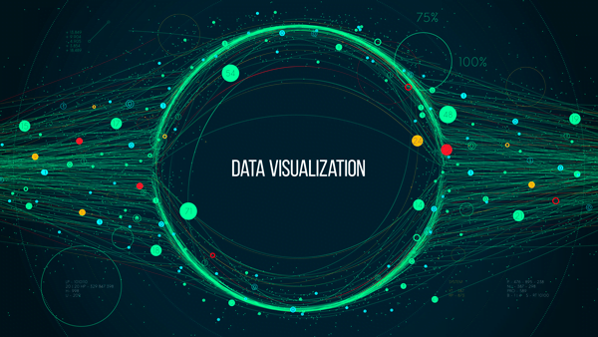

Slide 19

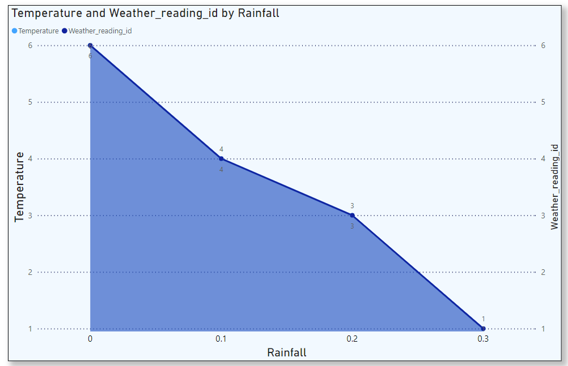
Temperature and
Weather by Rainfall

Slide 20
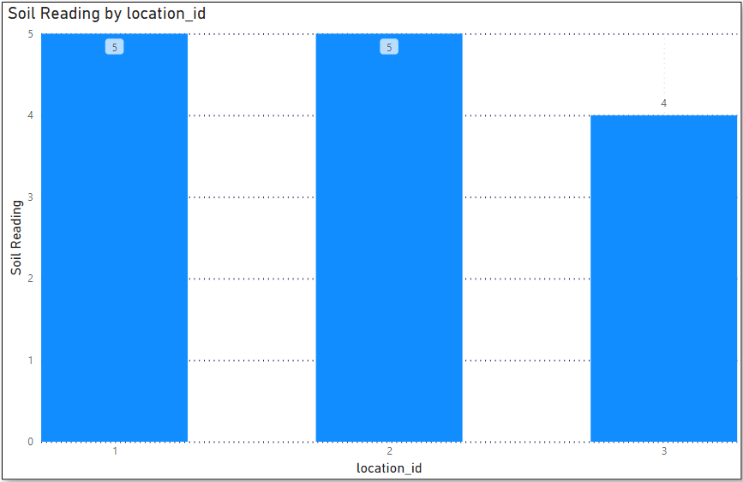
Soil Reading
at different locations

Slide 21
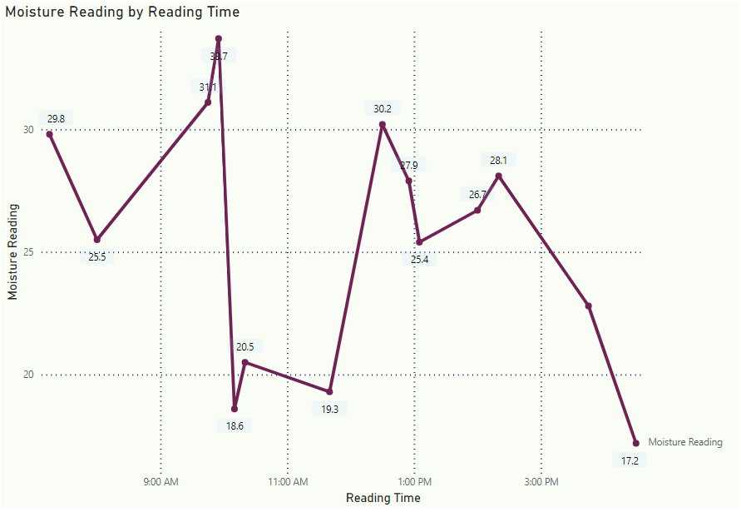
Moisture at
different times

Slide 22
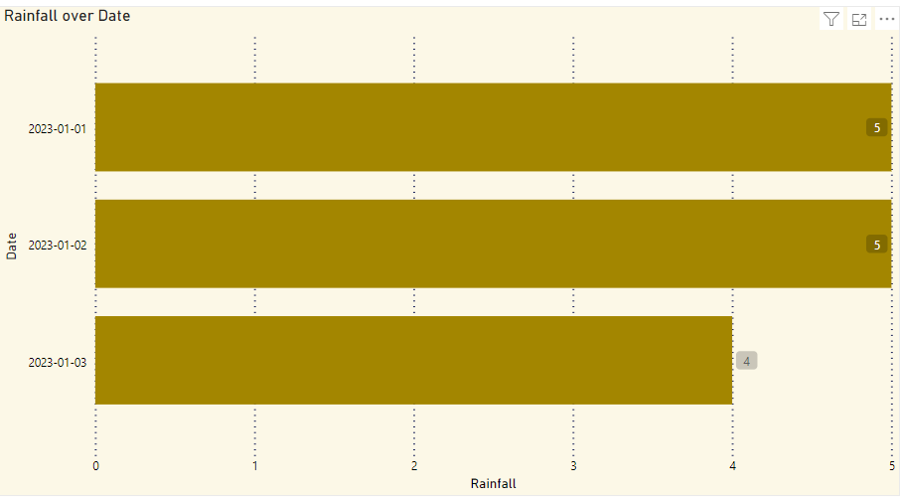
Rainfall on
various Date

Slide 23
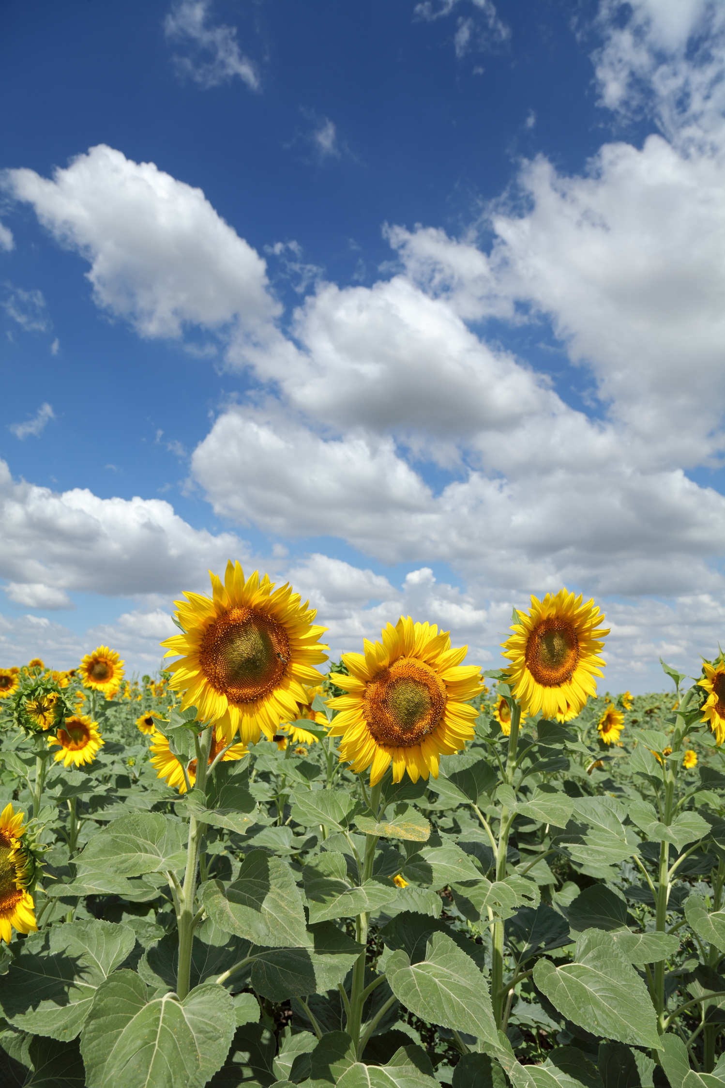
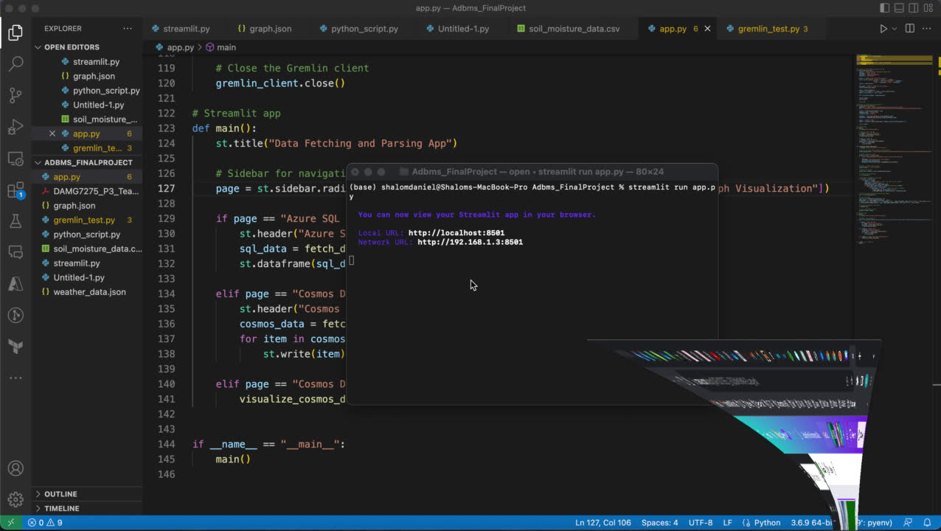



Slide 24
Future Scope
Test with a large dataset of soil
sensor & weather api data
Create Audit tables to
track changes in data
Completely automate process
remove manual interventions
More features for the end-user
dashboard
.

Slide 25


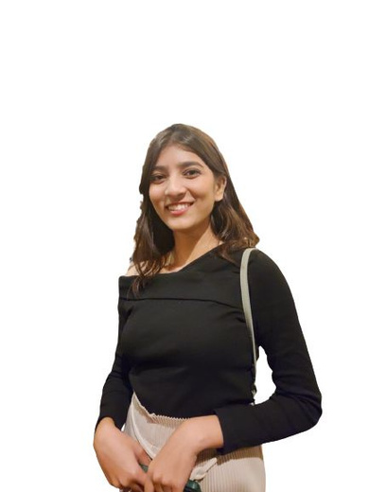


Ankita Patil
Keshni Mulrajani
Shalom Daniel
Sachit Wagle
Aditya Pande
THANK YOU!

